Slide 1
Managing Time Wisely
Take Time to Manage Time
By Shelly Smith

Slide 2

1. Prioritize Your Tasks
Use a To-Do List.
  It takes time to manage time.
  Put the most important tasks first.
  Add everything to your list both tasks you are dreading and looking forward too.
  Be sure to mark off items as you complete them, it psychologically gives you a sense of accomplishment. After all you must have accomplished something if you are crossing it off the list!

Slide 3
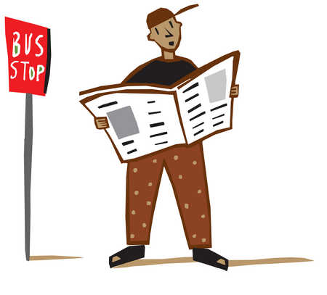
2. Make Your Work a Tag-a-long
Taking your work with you helps you use each available time slot wisely.
Anytime throughout the day you might find yourself waiting. You could be waiting at the doctors office, restaurant, or bus stop, but if you have your work you can complete an extra chapter of your assignment. (And the plus side? This didn’t even feel like work! )

Slide 4
3. Schedule Study Time
Figure out if you work better at night, in the morning, or dead center of the day. Schedule your study time when you are at your peak.
Study time is solely for your coursework. Facebook notifications, phone calls, e-mails, and texts will have to wait until you are finished.
Budget your time wisely. When compiling a to-do list be sure to add in your normal activities and planned activities but also remember to add in relaxation time. You will produce less efficiently and effectively if you do not schedule some “off” time throughout your day.
Lets take a poll and see when our groups peak study time is!

Slide 5

4. Keep Checking Your List and Say NO when needed
Check your list periodically throughout the day.
  If you find yourself unfocused or completing an unnecessary task ~ check your list to re-focus.
  Its ok to say no to a movie night when its finals week. Re-schedule your free time to a time that is not conflicting with your class work. (There will be other nights and other movies that you can see!)
How many times throughout the day do you check your to-do list?

Slide 6
5. Eat, Sleep and Be Merry!
It is important that you are eating properly. Be sure to have a healthy diet because this DOES effect your performance.
Sleep the night before.
  We have all heard of or tried to pull “all nighters” to try to score higher on an exam. Studies prove that sleeping well the night before an examination will benefit the test taker more than cramming until the last minute

Slide 7

6. Be Prepared and Work Ahead
Life happens. Children become ill, cars break down, and mindsets are hindered in all kinds of different manners. Be prepared! Don’t wait until the last minute to finish important tasks.
Have a back up plan and work ahead.
Remember: “crammed” information is
processed under your short-term memory and stress
depletes your short-term memory. You could be
cramming just to forget!

Slide 8

7. Keep the Finish Line in Mind
Remember why you are completing your tasks. Look at short-term and long-term goals.
Make a personal mission statement. Periodically check back to see if your daily tasks are supporting your personal mission statement.
Attitude is everything!
  “What is the difference between an obstacle and an opportunity? Our attitude toward it. Every opportunity has a difficulty, and every difficulty has an opportunity.” ― J. Sidlow Baxter

Slide 9
7 Tips on Managing Time Wisely
Prioritize Your Tasks
Make Your Work a Tag-a-long
Schedule Study Time
Keep Checking Your List and Say NO
Eat, Sleep, and Be Merry!
Be Prepared and Work Ahead
Keep the Finish Line in Mind

